Slide 1



Hotel
Reservation
Analysis
By Ahmed Rabie, Ali Ahmed, Aya Mahmoud, and Nayira

Slide 2

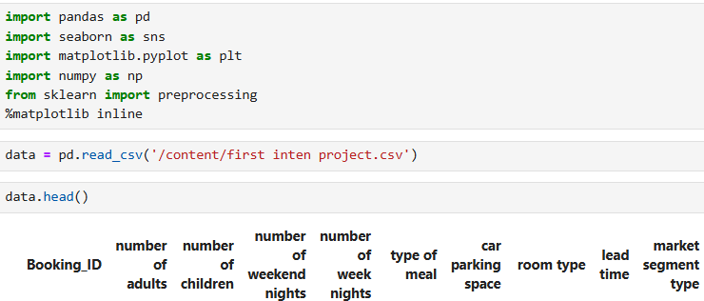
Introduction
We were given a dataset related to hotel reservations, so we started by importing the required libraries. Additionally, we read the CSV file and assigned it to a dataframe variable.

Slide 3

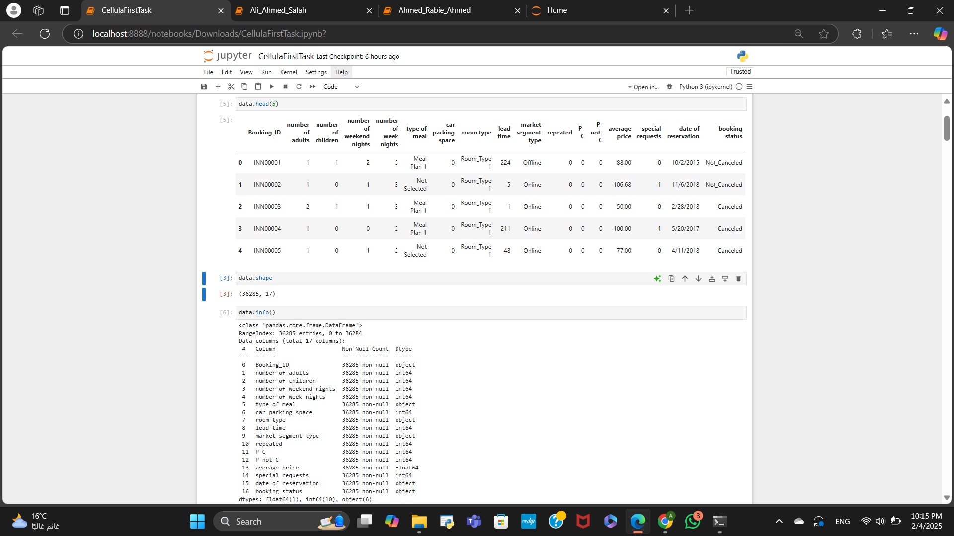
Data Exploration
Next, we began examining the data, including the types of features and the overall structure of the data as well.

Slide 4
Data Exploration,cont

Slide 5
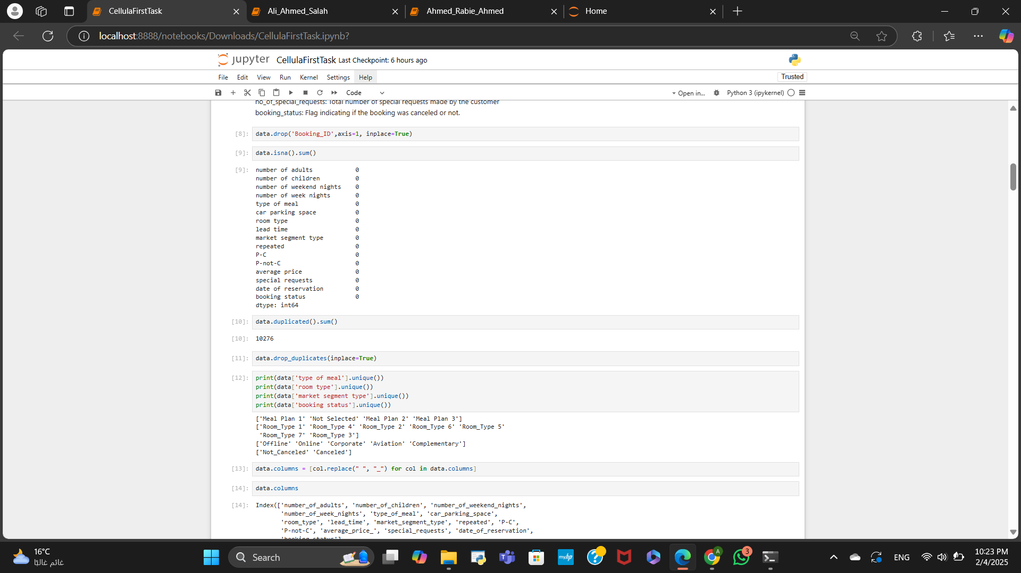


Data Cleaning
The next step involved cleaning the data by eliminating null values, duplicates, cost features, Renaming columns and outliers.

Slide 6
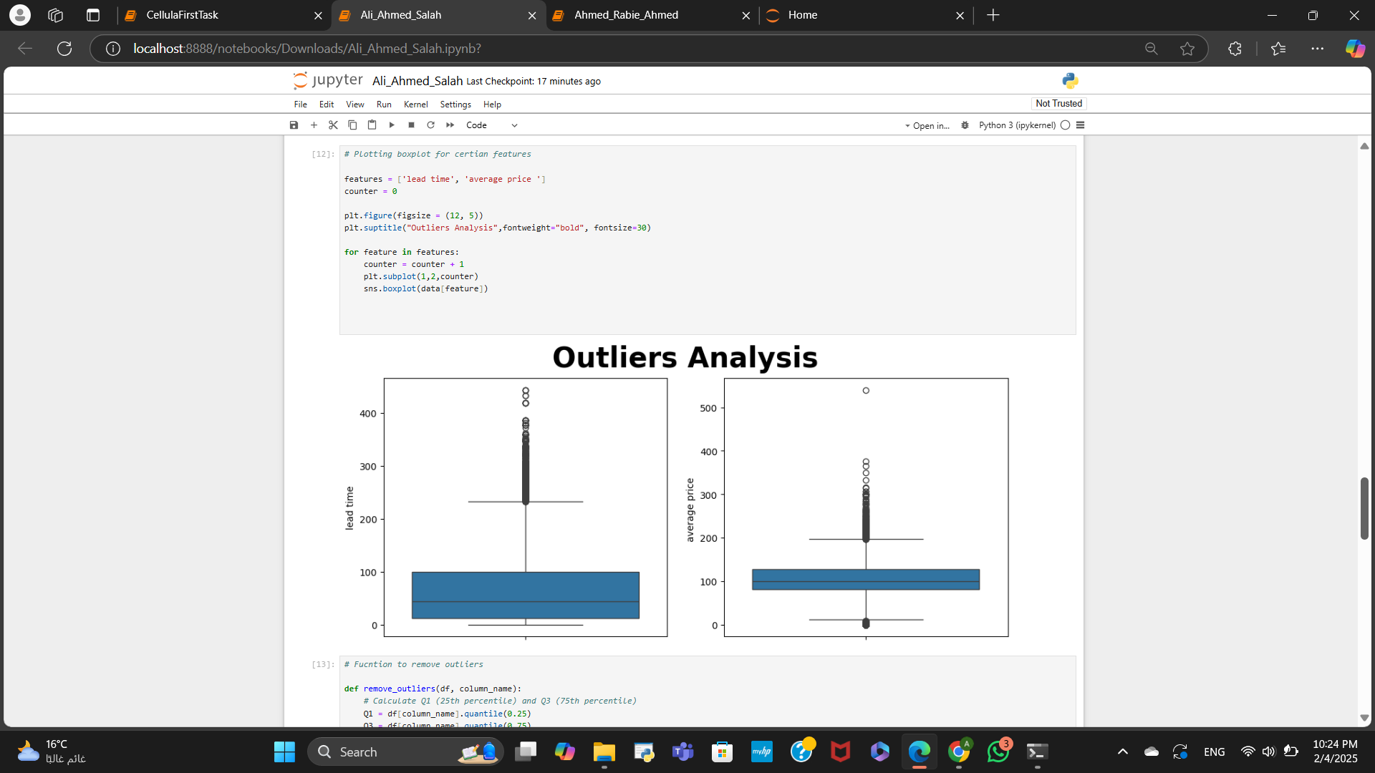
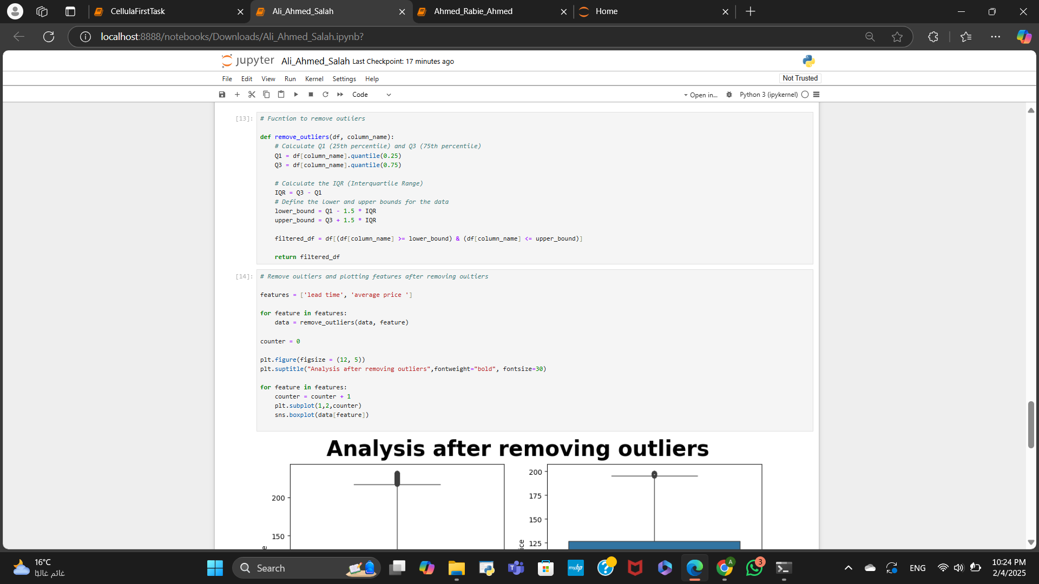
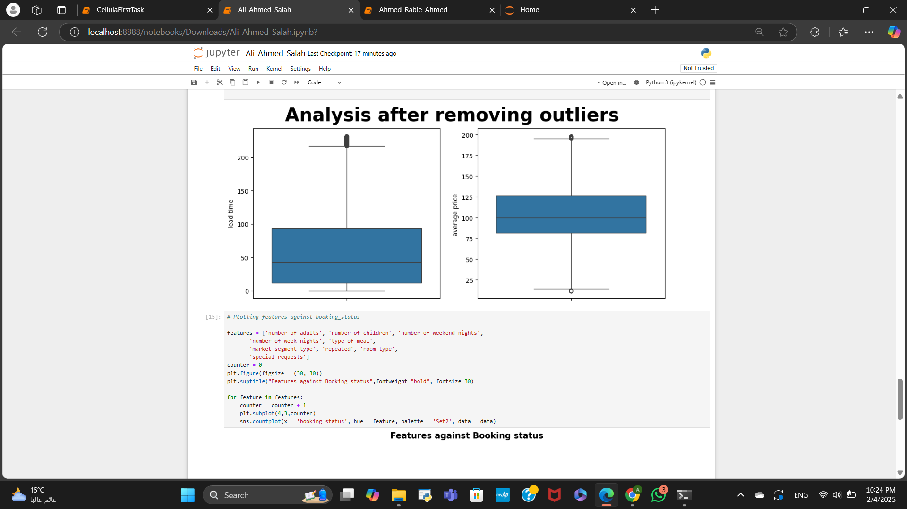
Here we removed outliers by plotting them and then using Q1 and Q3 to find IQR

Slide 7
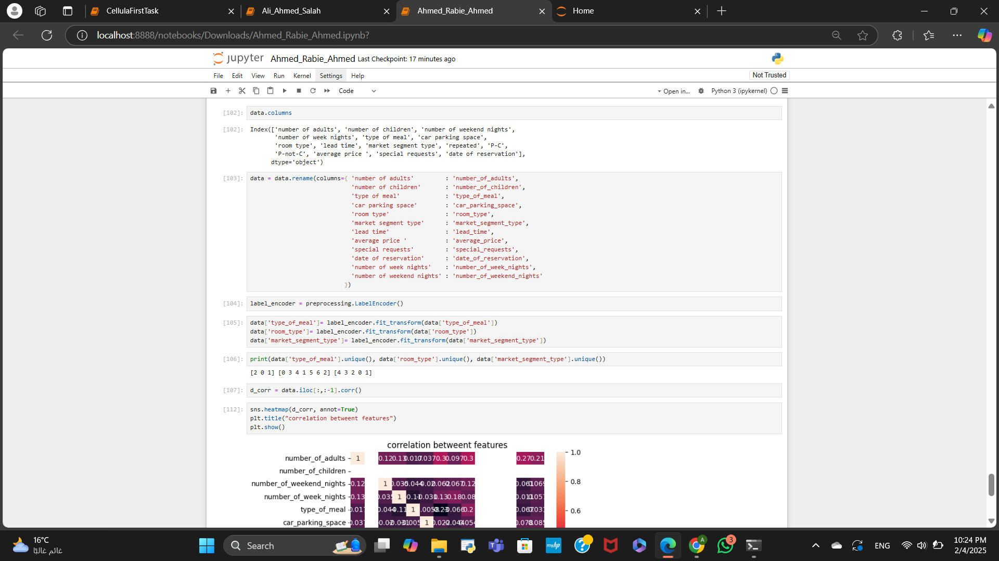
Column Renaming

Slide 8
For he hotel reservation we had 16 features(information about the customer)and the satues of the booking (did they cancel it or not )and they are
Booking_ID: unique identifier of each booking
no_of_adults: Number of adults
no_of_children: Number of Children
no_of_weekend_nights: Number of weekend nights the guest stayed or booked to stay at the hotel
no_of_week_nights: Number of week nights the guest stayed or booked to stay at the hotel
type_of_meal_plan: Type of meal plan booked by the customer:
required_car_parking_space: Does the customer require a car parking space? (0 - No, 1- Yes)
room_type_reserved: Type of room reserved by the customer.
lead_time: Number of days between the date of booking and the arrival date
arrival_year: Year of arrival date
arrival_month: Month of arrival date
arrival_date: Date of the month
market_segment_type: Market segment designation.
repeated_guest: Is the customer a repeated guest? (0 - No, 1- Yes)
no_of_previous_cancellations: Number of previous bookings that were canceled by the customer prior to the current booking
no_of_previous_bookings_not_canceled: Number of previous bookings not canceled by the customer prior to the current booking
avg_price_per_room: Average price per day of the reservation; prices of the rooms are dynamic.
no_of_special_requests: Total number of special requests made by the customer
booking_status: Flag indicating if the booking was canceled or not.

Slide 9

Nevertheless, the question still stands:
How do these features affect the status of the booking? Do elements like the number of guests, lead time, or room type have an influence?
As a proactive measure, we have begun creating visualizations to assist us in tackling these issues.

Slide 10
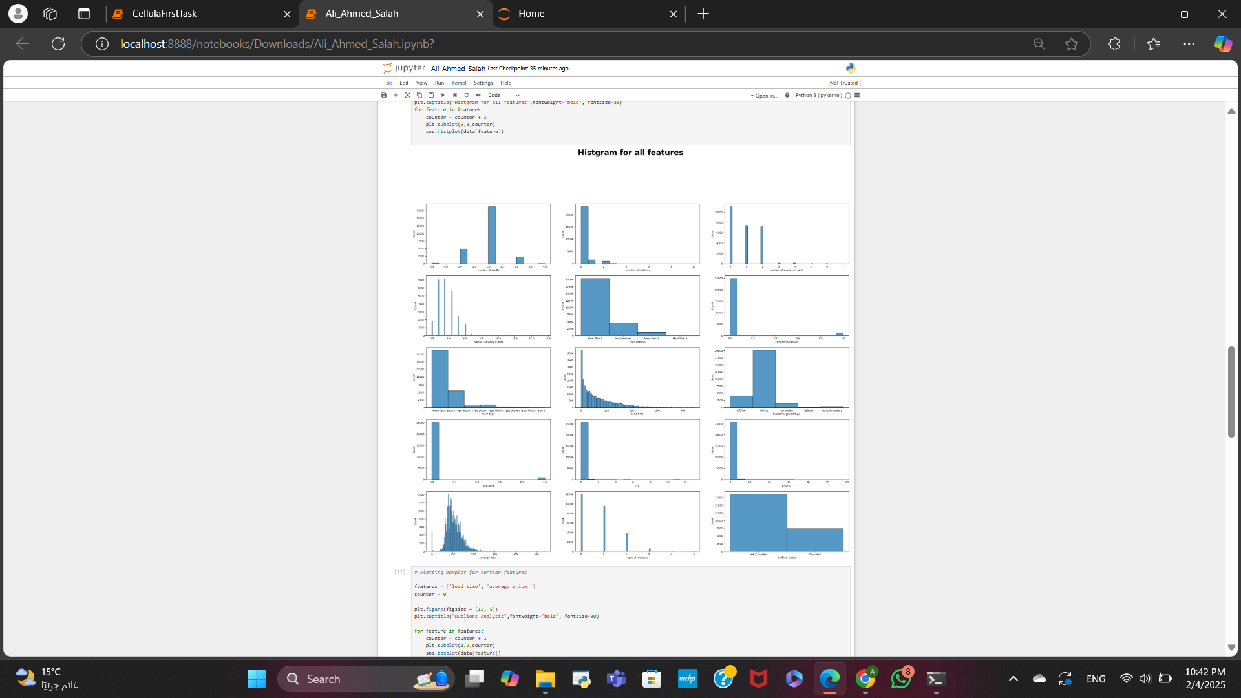
Data Visualization and Drawing Conclusions,cont
Creating histograms for all features to display the values corresponding to each count.

Slide 11

Generating histograms for all features to illustrate the values associated with each count.
This analysis helped us assess the range of values for each feature, leading us to conclude that customers without parking facilities outnumber those with parking. If we increase the number of parking spots, we could potentially reduce the cancellation rate.
Additionally, we see that the online segment brings in more customers than any other category.
Meal Type 1 and Room Type 1 are the most frequently booked options—could this be due to their affordability, or are they simply the better choices?
Let's explore this further.

Slide 12
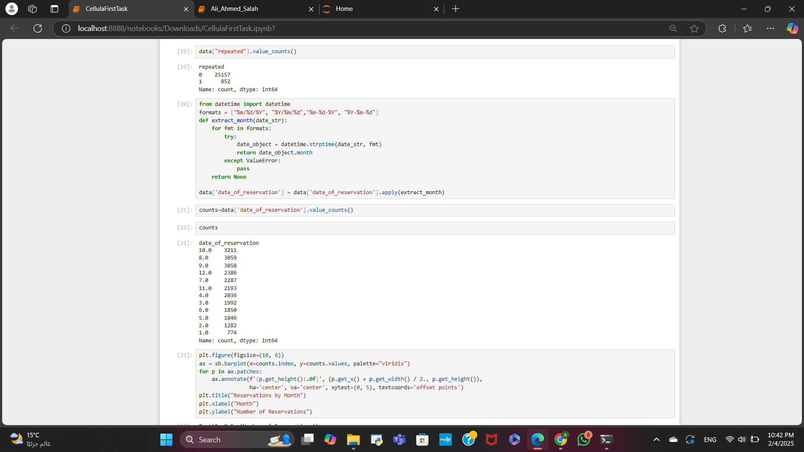
Data Visualization and Drawing Conclusions
We analyzed the months from the reservation dates to determine which month has the highest reservation rate and which does not.

Slide 13
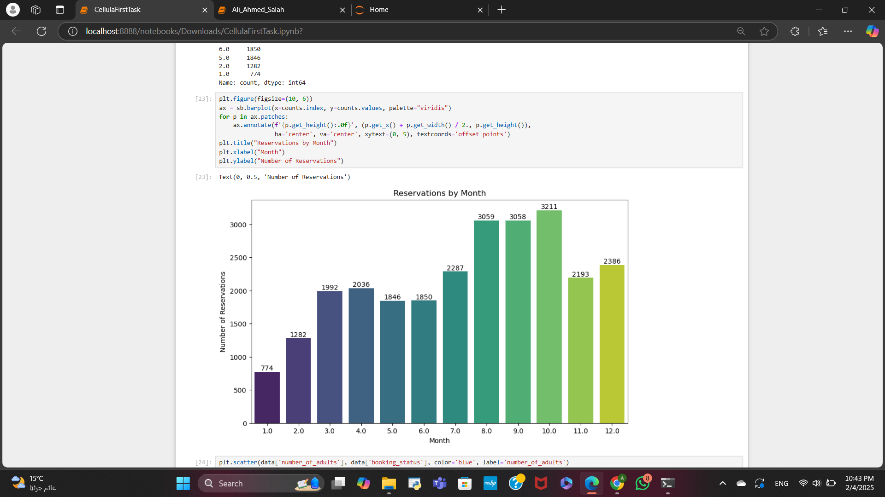
Data Visualization and Drawing Conclusions,cont
As you can see, October shows the highest numbers, whereas January has the lowest. However, does this trend impact cancellation rates?

Slide 14
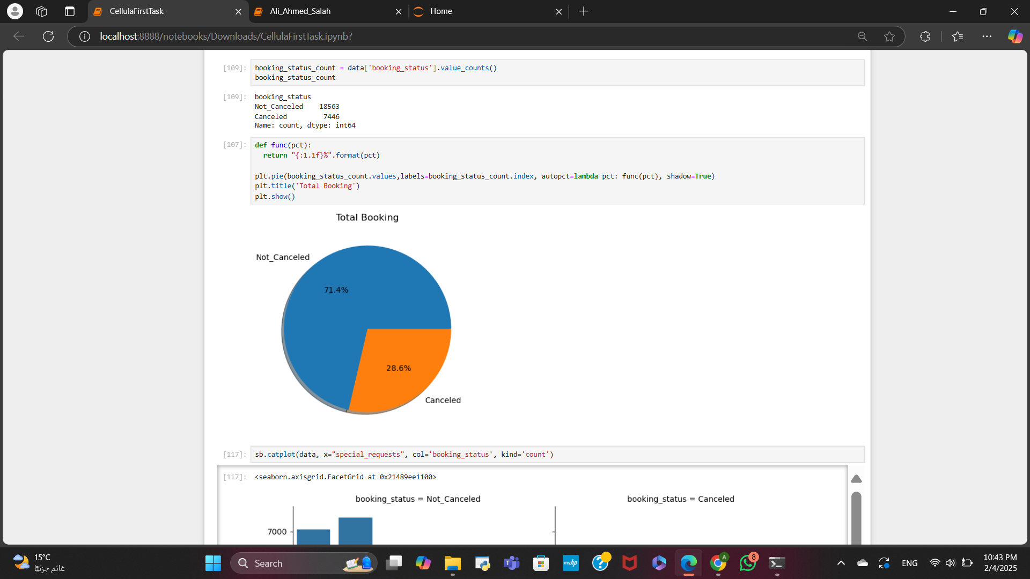
Data Visualization and Drawing Conclusions,cont
Here is a pie chart illustrating the percentages of canceled versus non-canceled booking statuses.

Slide 15
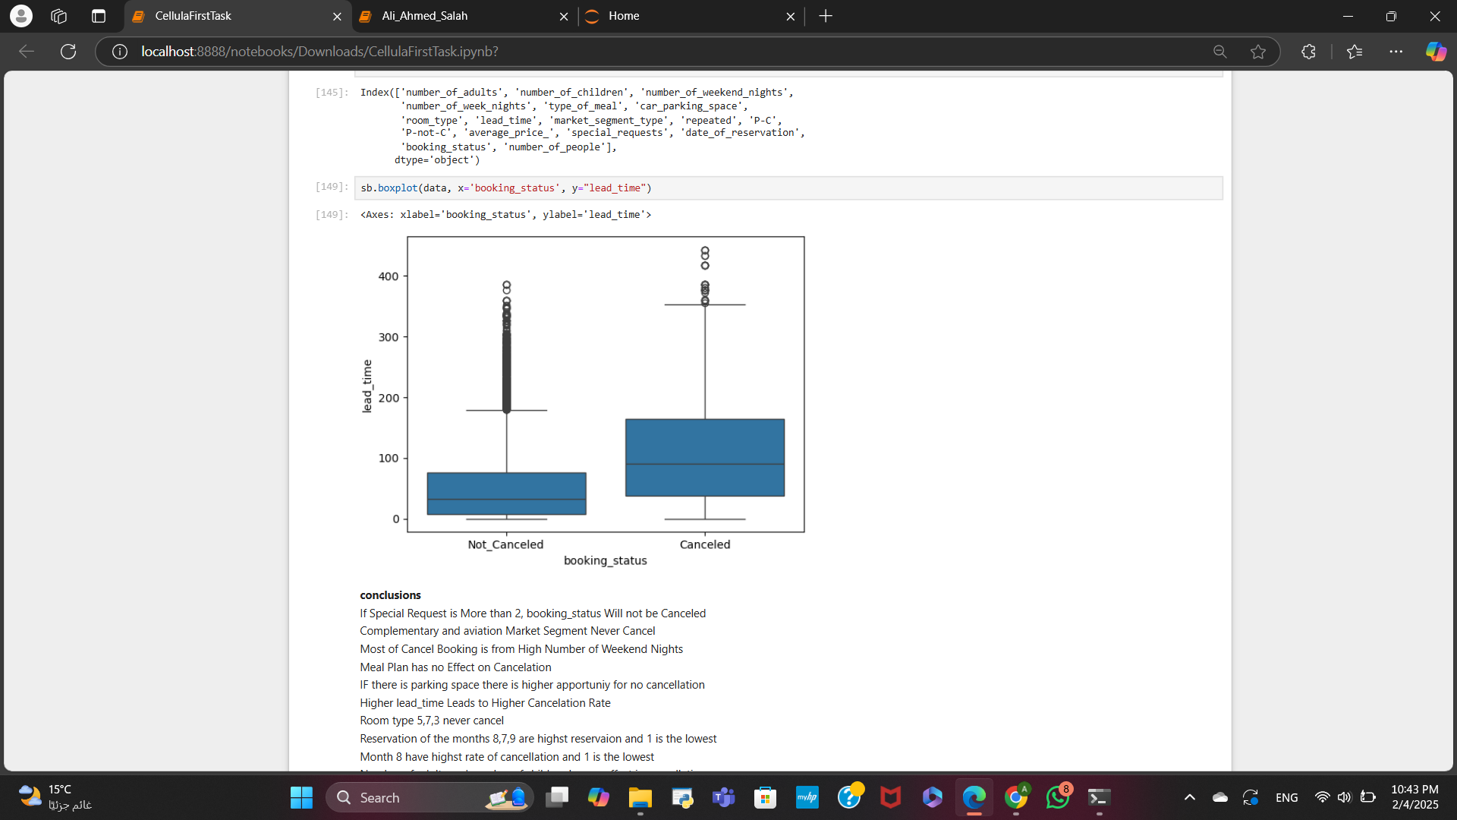
Data Visualization and Drawing Conclusions,cont
This box plot illustrates whether lead time impacts the cancellation percentage. As you can see, a longer lead time corresponds to a higher cancellation rate.

Slide 16
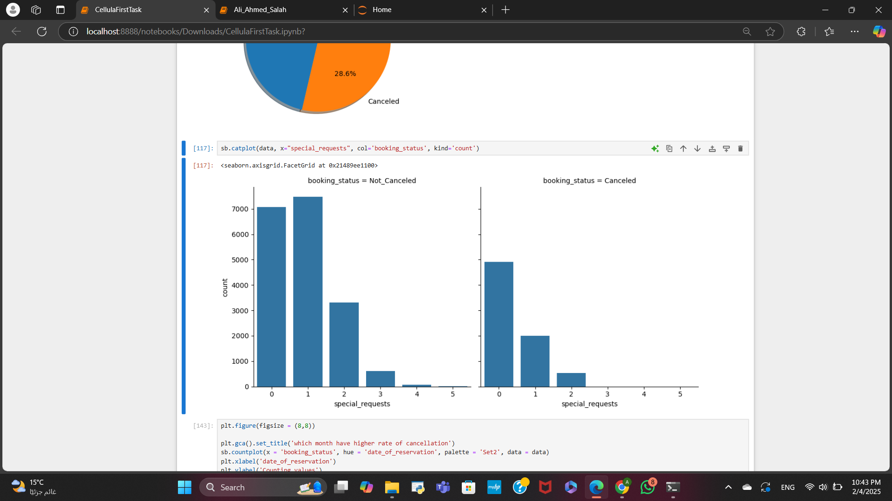
Data Visualization and Drawing Conclusions,cont
This cat plot illustrates whether special requests impacts the cancellation percentage.
As you can see, if the user have more then 2 special requests he will not cancel.

Slide 17
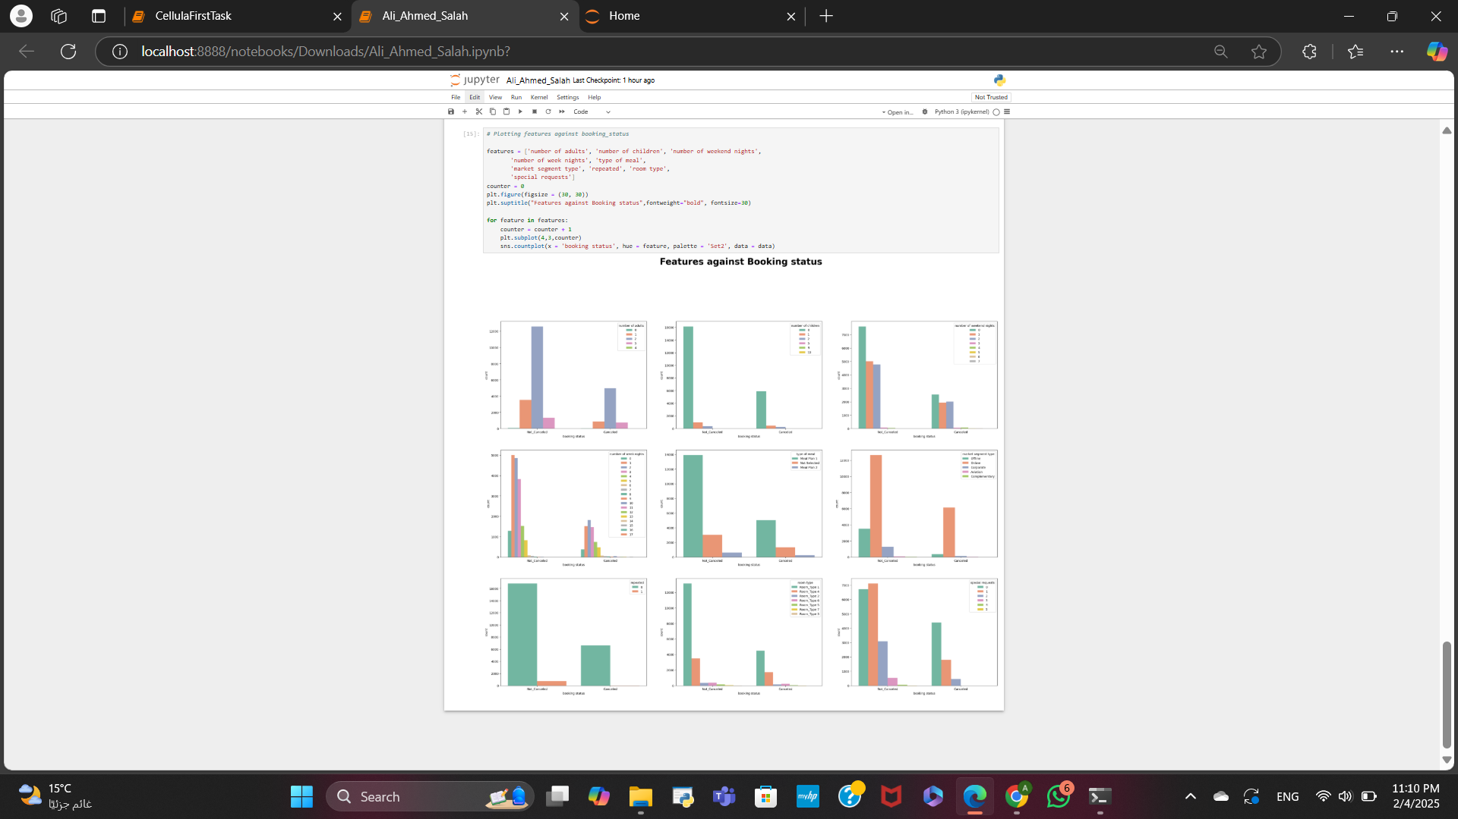
Data Visualization and Drawing Conclusions,cont
Here is a count plot that categorizes each feature according to booking status, helping us identify the factors that contribute to cancellations. We reached numerous conclusions from this analysis, which we then excluded.

Slide 18

Conclusions
If Special Request is More than 2, booking_status Will not be Canceled.
Complementary and aviation Market Segment Never Cancel.
Most of Cancel Booking is from High Number of Weekend Nights.
Meal Plan has no Effect on Cancelation.
IF there is parking space there is higher apportuniy for no cancellation.
Higher lead_time Leads to Higher Cancelation Rate.
Room type 5,7,3 never cancel.
Reservation of the months 8,7,9 are highst reservaion and 1 is the lowest
Month 8 have highst rate of cancellation and 1 is the lowest.
Number of adults and number of children has no effect in cancellation.

Slide 19

Improvements
Focusing on the Complementary and Aviation Market Segment, we aim to understand online customers' challenges to lower cancellation rates.
Increase the availability of parking spots
Analyze lead time issues and work on reducing it
Introduce additional room types: 5, 7, and 3.

Slide 20

Thank you very much!

